Slide 1

Image Data Engineering
Lt Ben Hepner, Lt Haley Traub, Lt Joshua Edmonds & Captain Michael Alan Wegner
Notes:
Ben

Slide 2
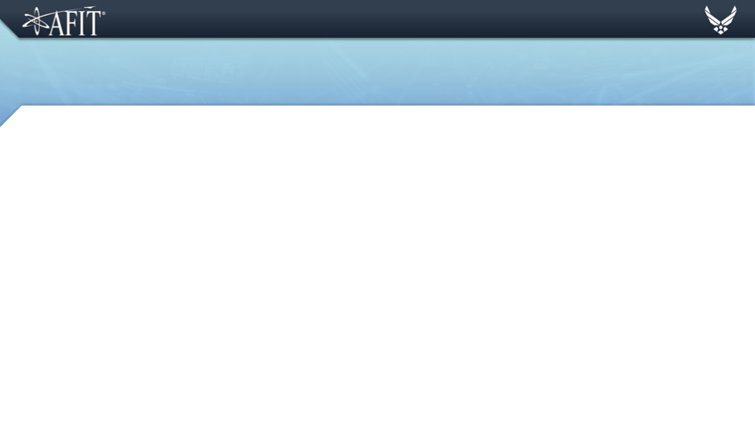
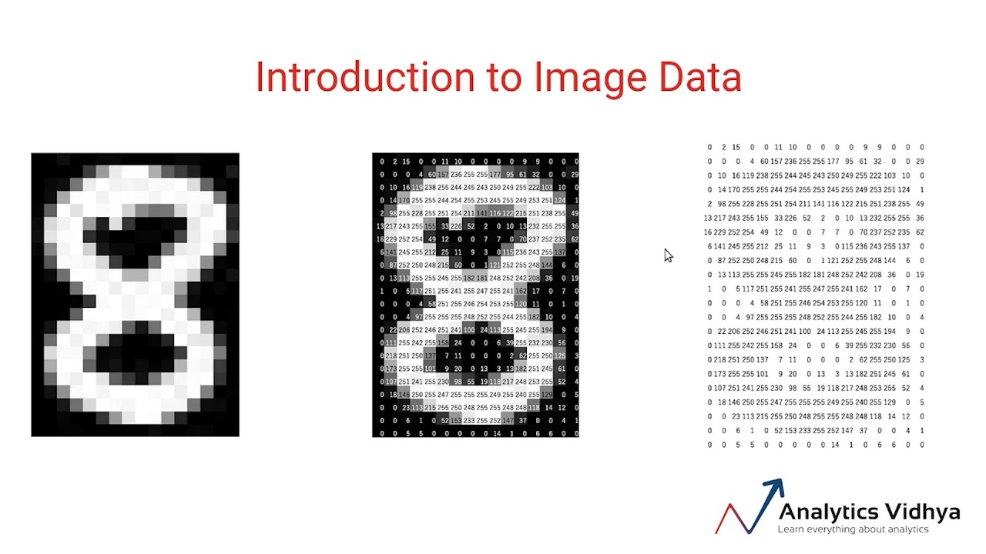
Introduction to Image Data
Computers look at images much differently than we do.
Where we see can easily see an ‘8’, a computer can only understand the components an image is created from.
Notes:
Just a talking slide. Make sure to emphasize that images are matrices. (Ben)

Slide 3
Lossless vs Lossy Image Compression
File Compression → what can be recovered?
Compression = reducing image size
Lossless
Quality remains same
Restores and rebuilds file data to its original form
Reverse compression
Lossy
Data is lost when compressed → irreversible compression
Data quality is compromised
Easier to store and transmit
Notes:
https://www.geeksforgeeks.org/difference-between-lossy-compression-and-lossless-compression/

Slide 4
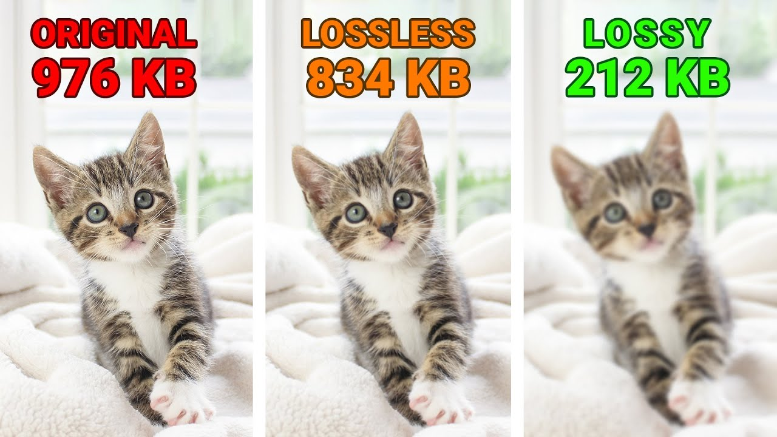
Lossless vs Lossy Image Compression- Example
Need a smaller file?
Original
Large file
Clear picture
Lossless
Medium file
Mostly clear
Lossy
Small file
Foggy image
Notes:
Hepner

Slide 5
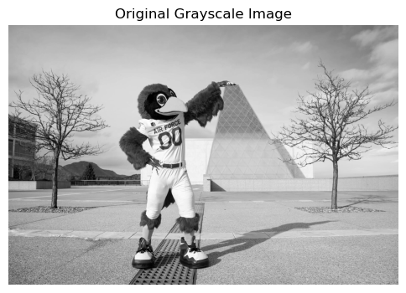
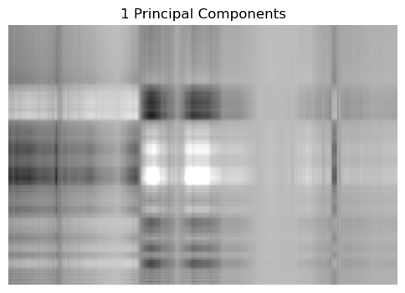
PCA Examples
Original File Size
.09% of the File Size
Notes:
Hepner

Slide 6

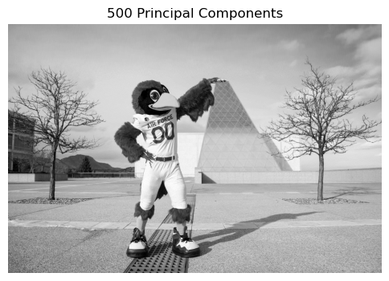
PCA Examples
9.7% of the Image File
48.7% of the File Size
Notes:
Hepner

Slide 7
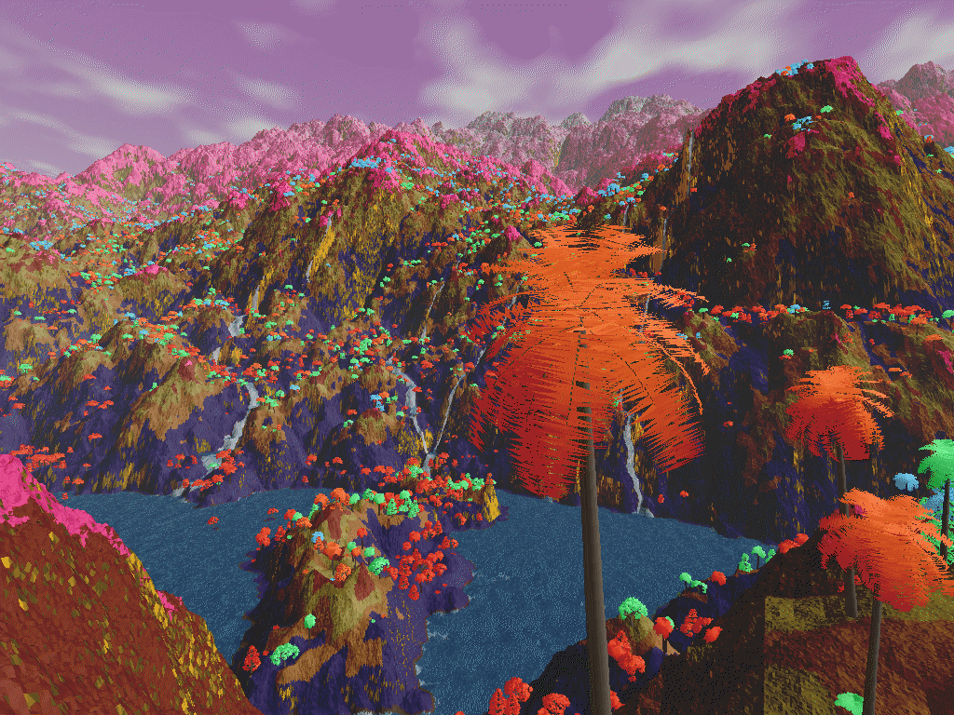
Lossless Image Formats
PNG
Portable Network Graphics in 1996
Uses lossless compression
High Quality photos
BMP
Bitmap
Windows Environment
Stores images independently of display platform
Typically large file sizes
GIF
Graphics Interchange Format
256 color palette, can contain animations
TIFF
Tagged Image File Format
Advanced photography
Notes:
https://creativemarket.com/blog/difference-between-jpg-png-bmp-tiff-images
1. JPEG (Joint Photographic Experts Group)
Usage: Widely used for digital photography and web images.
Features: Offers high compression ratios, which can significantly reduce file size at the cost of some quality loss due to its lossy compression.
Best for: Photographs and realistic scenes with smooth variations in tone and color.
2. PNG (Portable Network Graphics)
Usage: Common for web images, especially when transparency is needed.
Features: Provides lossless compression, meaning it retains original image quality while reducing file size. Supports transparency (alpha channel).
Best for: Images requiring high quality and transparency, like logos, graphics, and text.
3. GIF (Graphics Interchange Format)
Usage: Popular for web graphics, small animations, and low-resolution video clips.
Features: Supports lossless compression, limited to a 256-color palette, and can contain multiple images for animations. Also supports transparency but not partial (alpha channel) transparency.
Best for: Simple animations and graphics with limited colors.
4. TIFF (Tagged Image File Format)
Usage: Used in scanning, desktop publishing, and professional photography.
Features: Supports lossless compression and can store image data in a variety of color spaces and bit depths. Capable of storing multiple images and layers in a single file. Can include extensive metadata.
Best for: High-quality image archiving and manipulation without loss of information.
5. BMP (Bitmap Image File)
Usage: Native to the Windows environment, used for storing bitmap digital images.
Features: Uncompressed format that maintains high quality but results in large file sizes. Supports various color depths.
Best for: Applications where image quality is more important than file size and compatibility is needed with Windows applications.
6. RAW
Usage: Used in digital photography.
Features: Contains minimally processed data from the image sensor of a digital camera, scanner, or motion picture film scanner. Offers the highest possible quality, as it's uncompressed and contains more data, allowing for more flexibility in post-processing.
Best for: Professional photography where post-processing is expected.
7. WebP
Usage: Developed by Google for web images.
Features: Supports both lossy and lossless compression, providing high-quality images at smaller file sizes compared to JPEG and PNG. Also supports transparency and animation.
Best for: Web applications requiring high-quality images with efficient compression.
8. SVG (Scalable Vector Graphics)
Usage: Used for vector graphics on the web.
Features: XML-based format for describing two-dimensional vector graphics, both static and dynamic. Scalable without loss of quality, making it ideal for logos, icons, and complex illustrations.
Best for: Web and print graphics that need to be scaled to different sizes without losing quality.
Each format has its niche, balancing factors such as file size, compatibility, image quality, and specific features like transparency and animation. The choice of format depends on the specific requirements of the image processing task, the intended use of the images, and the need for compression versus quality.

Slide 8
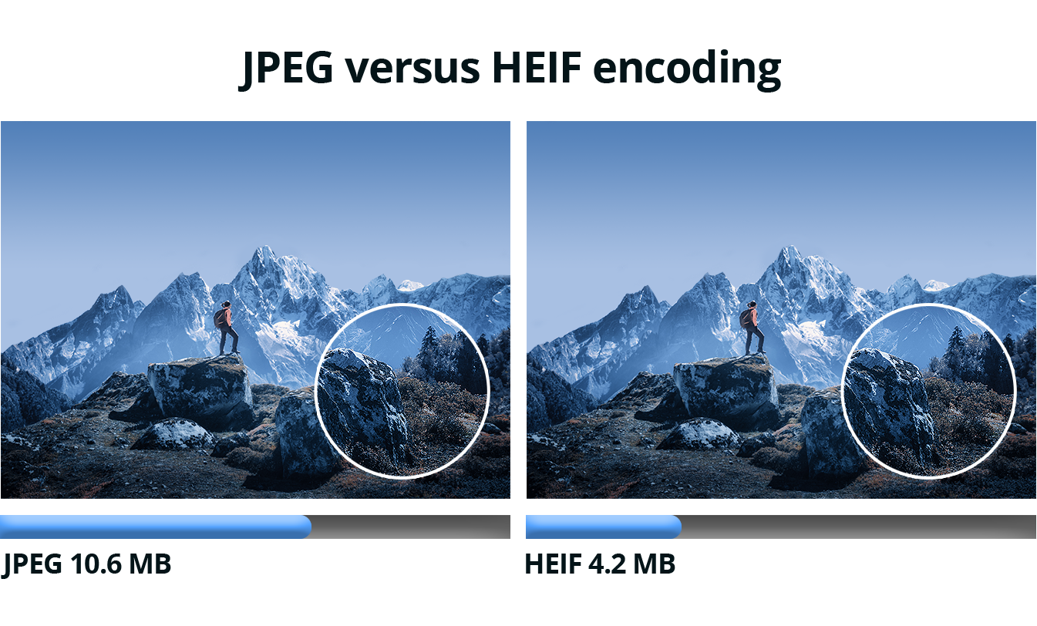
Lossy Formats
JPEG
Joint Photographic Experts Group in 1992
Lossy compression in data images
Reduce size so it is easier to store (high compression rates)
Webp (support both)
Smaller than JPEG with comparable quality
Developed by Google
HEIF (support both)
High Efficiency Image Format
Better compression than JPEG with less degradation in quality
How do we store these data file formats? (read it → map to data structure)
Notes:
https://creativemarket.com/blog/difference-between-jpg-png-bmp-tiff-images
1. JPEG (Joint Photographic Experts Group)
Usage: Widely used for digital photography and web images.
Features: Offers high compression ratios, which can significantly reduce file size at the cost of some quality loss due to its lossy compression.
Best for: Photographs and realistic scenes with smooth variations in tone and color.
2. PNG (Portable Network Graphics)
Usage: Common for web images, especially when transparency is needed.
Features: Provides lossless compression, meaning it retains original image quality while reducing file size. Supports transparency (alpha channel).
Best for: Images requiring high quality and transparency, like logos, graphics, and text.
3. GIF (Graphics Interchange Format)
Usage: Popular for web graphics, small animations, and low-resolution video clips.
Features: Supports lossless compression, limited to a 256-color palette, and can contain multiple images for animations. Also supports transparency but not partial (alpha channel) transparency.
Best for: Simple animations and graphics with limited colors.
4. TIFF (Tagged Image File Format)
Usage: Used in scanning, desktop publishing, and professional photography.
Features: Supports lossless compression and can store image data in a variety of color spaces and bit depths. Capable of storing multiple images and layers in a single file. Can include extensive metadata.
Best for: High-quality image archiving and manipulation without loss of information.
5. BMP (Bitmap Image File)
Usage: Native to the Windows environment, used for storing bitmap digital images.
Features: Uncompressed format that maintains high quality but results in large file sizes. Supports various color depths.
Best for: Applications where image quality is more important than file size and compatibility is needed with Windows applications.
6. RAW
Usage: Used in digital photography.
Features: Contains minimally processed data from the image sensor of a digital camera, scanner, or motion picture film scanner. Offers the highest possible quality, as it's uncompressed and contains more data, allowing for more flexibility in post-processing.
Best for: Professional photography where post-processing is expected.
7. WebP
Usage: Developed by Google for web images.
Features: Supports both lossy and lossless compression, providing high-quality images at smaller file sizes compared to JPEG and PNG. Also supports transparency and animation.
Best for: Web applications requiring high-quality images with efficient compression.
8. SVG (Scalable Vector Graphics)
Usage: Used for vector graphics on the web.
Features: XML-based format for describing two-dimensional vector graphics, both static and dynamic. Scalable without loss of quality, making it ideal for logos, icons, and complex illustrations.
Best for: Web and print graphics that need to be scaled to different sizes without losing quality.
Each format has its niche, balancing factors such as file size, compatibility, image quality, and specific features like transparency and animation. The choice of format depends on the specific requirements of the image processing task, the intended use of the images, and the need for compression versus quality.

Slide 9
Curated Datasets
Already talked about:
MNIST (Modified National Institute of Standards and Technology) database
Microsoft Common Objects in Context (COCO) dataset:
Spacenet!
Amazon Web Services (AWS)
~67,000 square km of very high-resolution imagery
>11M building footprints
~20,000 km of road labels
Ensure that there is adequate open source data available for geospatial machine learning research

Slide 10
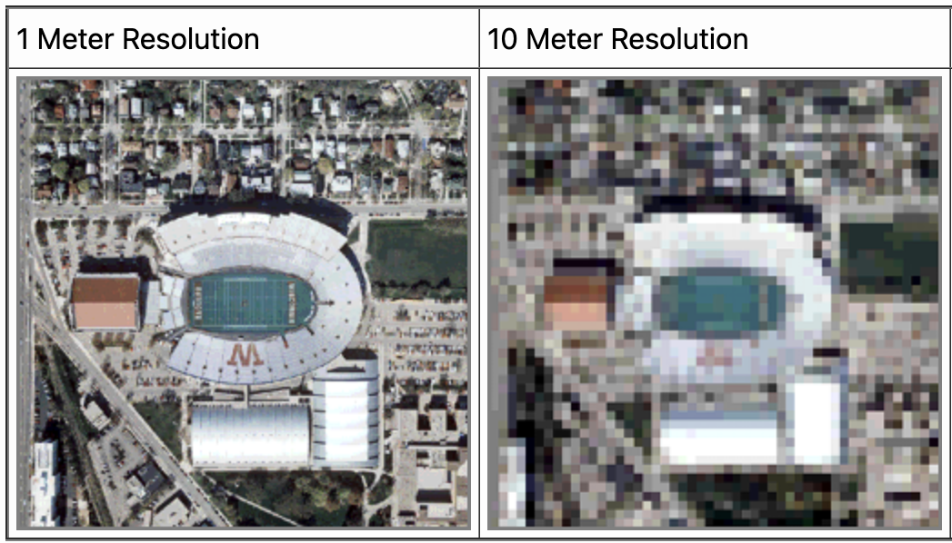
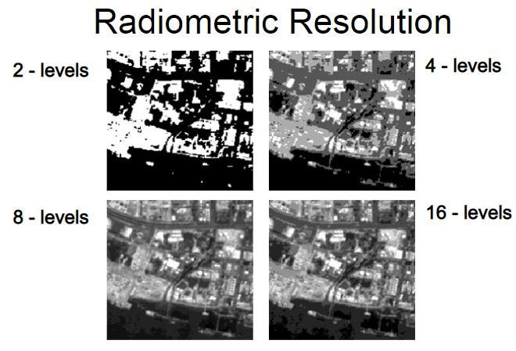
Types of Resolution
Spatial Resolution
“How many pixels are in the image”
Radiometric Resolution
“How many bits of data, per color are allocated to each pixel”
Both can drastically increase the size of the data at an exponential rate.
Notes:
Hep

Slide 11
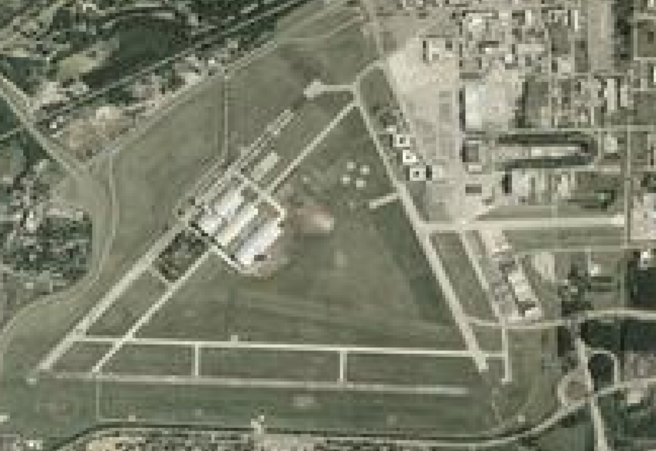
2004 NAIP Imagery: NM of USAF
Pixelated
(Raster)
3 hangers in museum
Harder to make out details within the image
(Lower spatial resolution)
Can make out general shapes, but colors are fairly similar
(Lower radiometric resolution)
Notes:
Hep

Slide 12
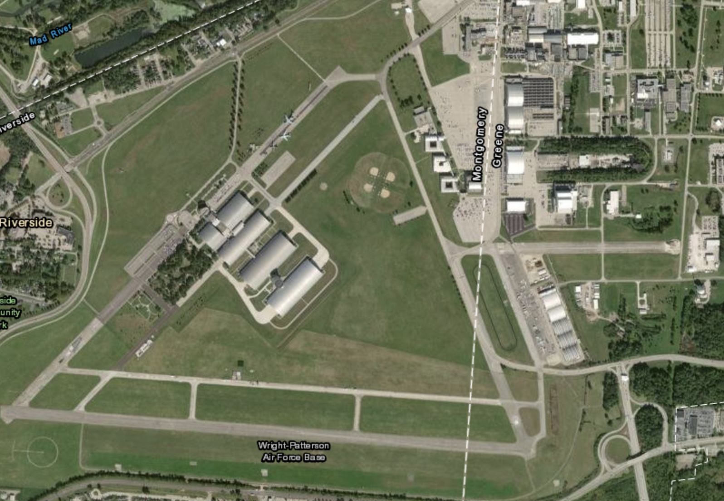
2023 NAIP Imagery: NM of USAF
Less pixelated
(Still Raster)
4 hangers in the museum
Easier to make out details within the image
(Higher spatial resolution)
Easier to make out general shapes and colors
(Higher radiometric resolution)
Notes:
Hep

Slide 13
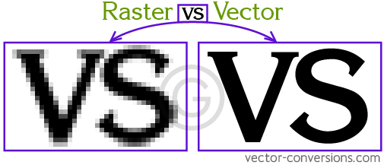
Raster vs. Vector
Raster is composed of pixels; Vector is composed of paths
Raster files are typically smaller; Vector files can be most costly, depending on the complexity of the shape.
Raster gets pixelated when zoomed in upon; Vector is infinitely zoomable.
Most satellite imagery is raster.
Notes:
Hep

Slide 14
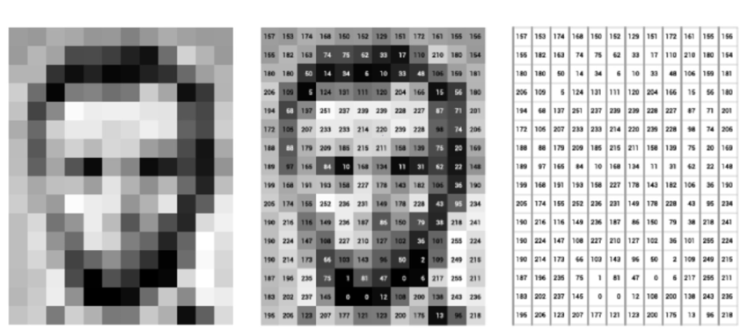
Data Structures- Arrays & Matrices
2D Matrices
Grayscale
Pixel’s intensity
8 bit scale from 0-255
Different bit depths exist
3D Matrices
Same as 2D
3rd Dimension represents RGB
Pixel intensity varies
Uses
Linear transformations (scaling, rotations, translations, sampling)
Convolutions
https://scikit-image.org/skimage-tutorials/lectures/00_images_are_arrays.html

Slide 15
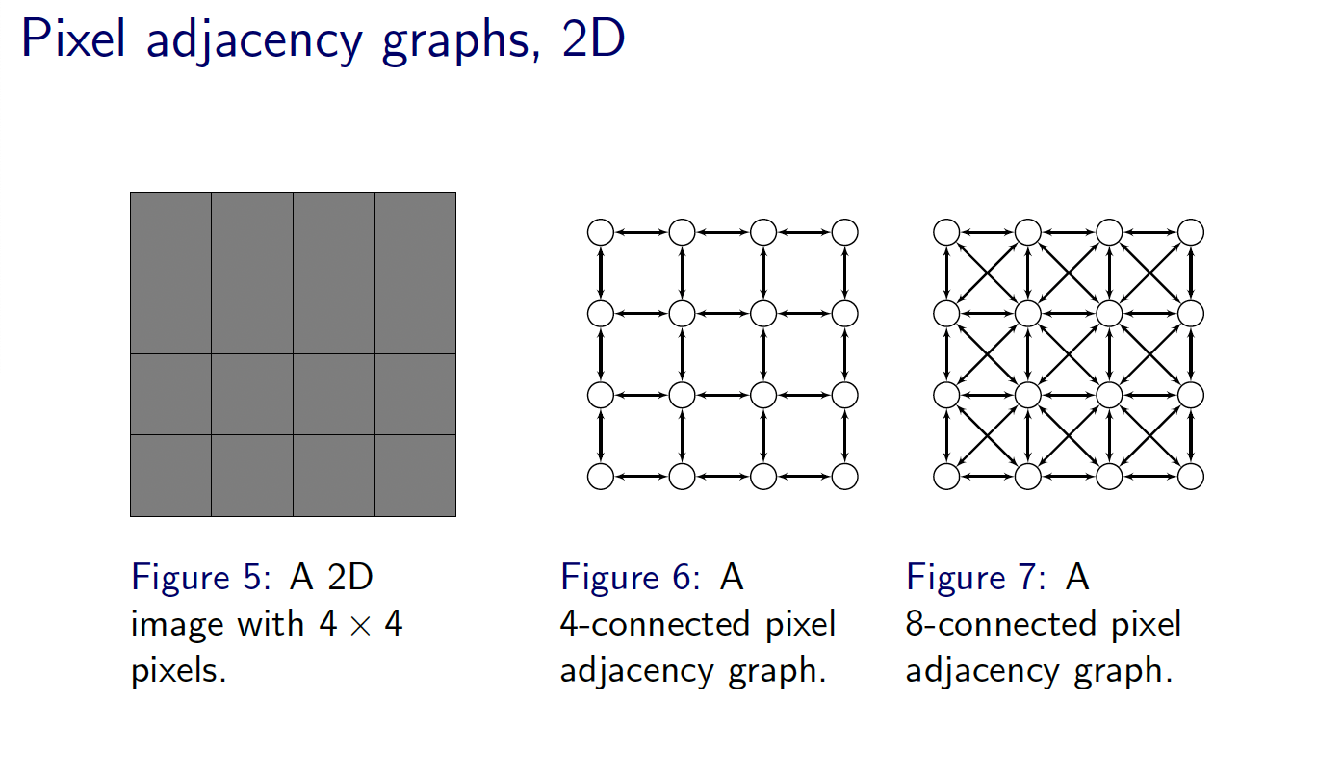
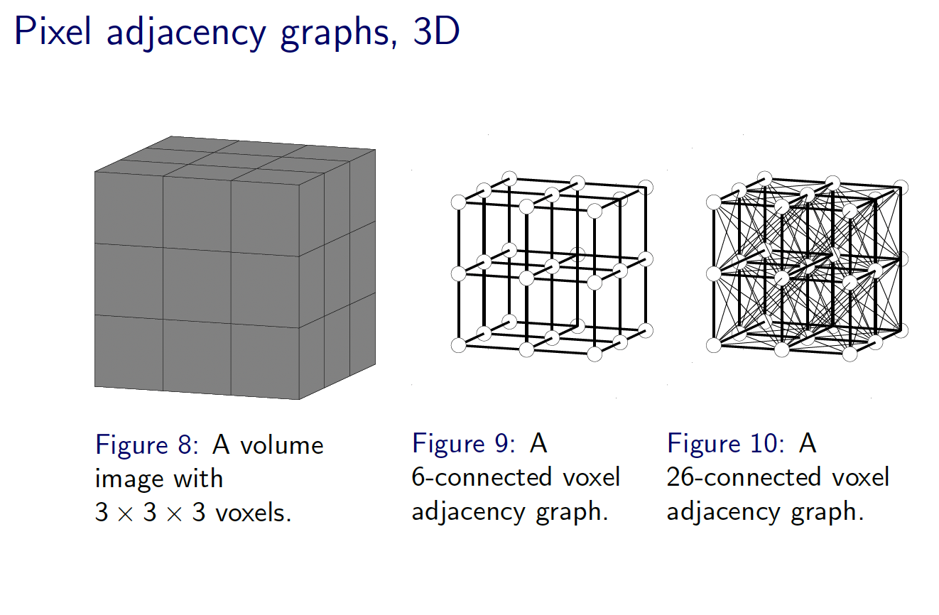
Data Structures- Graphs
Vertex → each pixel
Edge → certain criteria
Proximity
Color similarity
Gradient similarity
Weights → similarity/ dissimilarity with neighbors
Good for image segmentation, edge detection, etc (pre transformation)
https://sandipanweb.wordpress.com/2018/02/25/graph-based-image-segmentation-in-python/

Slide 16
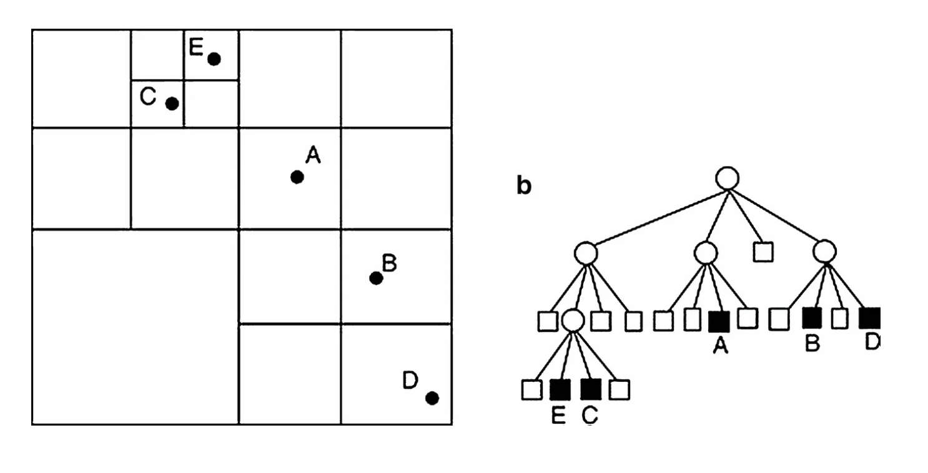
Data Structures- Trees
Organizes data hierarchically
Enables efficient algorithms for image analysis, manipulation, compression
Quadtree, octree, region quadtree, etc
Quadtree
Each node = 4 children
Divide spaces into smaller subspaces
Threshold for information (divide into 4 more subspaces once met)
Image compression, segmentation, spatial indexing, etc
https://medium.com/@tannerwyork/quadtrees-for-image-processing-302536c95c00

Slide 17
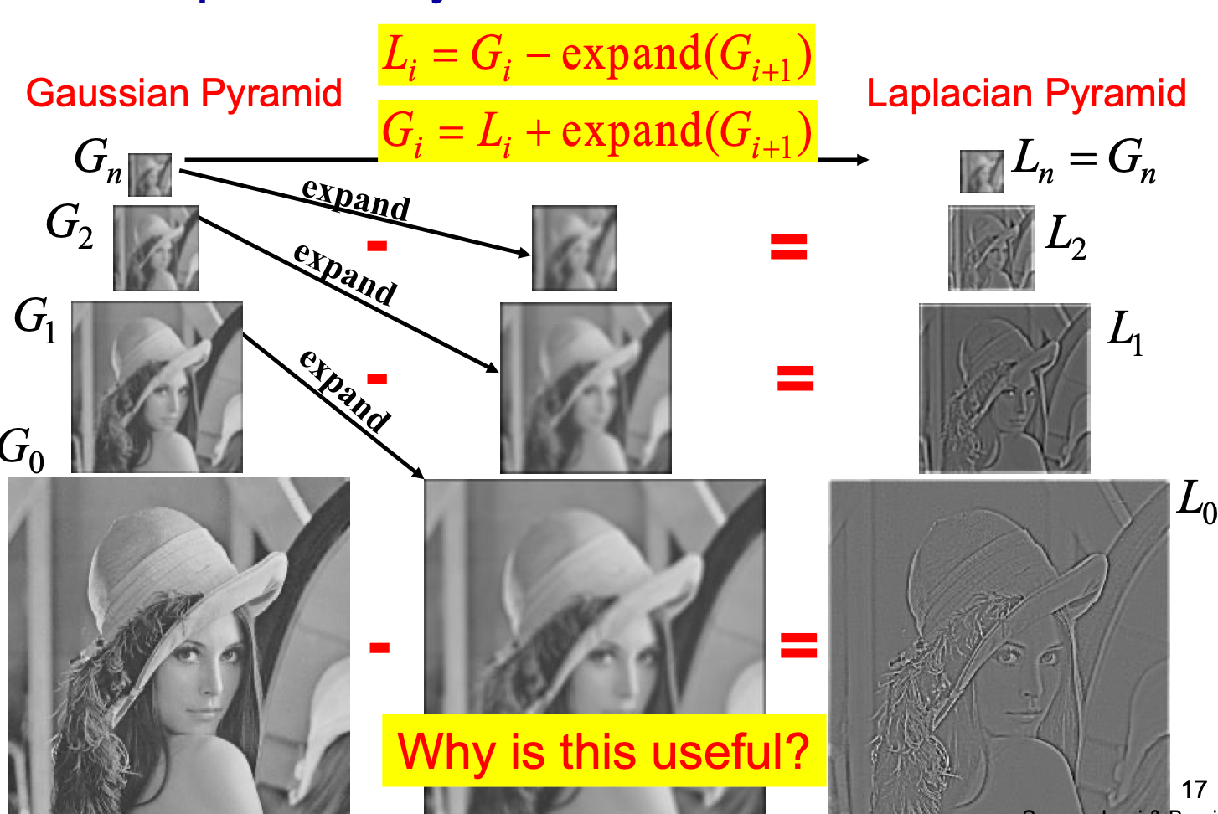
Data Structures- Pyramids
POP QUIZ
Used to represent data at different resolutions
Each level has a lower resolution than the one prior
Two Types
Gaussian
Downsampling
Apply Gaussian filter to one prior
Subsample it
Laplacian
Build on top of the pyramid
Store difference between gaussian and the expansion
Captures high frequency details that are lost
Applications
Upsampling, Down sampling, Image blending, Image compression, Feature Extraction
https://www.tutorialspoint.com/how-to-find-gaussian-pyramids-for-an-image-using-opencv-in-python
Red, blue and green levels are encoded up to what number?
256
255
8
10
What is the most data structure is used in down sampling, up sampling and convolutions?
Matrices
Trees
Graphs

Slide 18
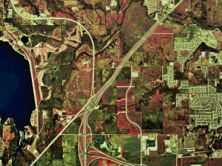
How GIS Tools Store Images
Raster Dataset:
Most GIS tools offer a way to store raster images on them.
Singular images.
Struggles to cover larger areas.
Works good with location specific problems
Individuals store them in file system, companies store them in RDBMS.
Notes:
Hep

Slide 19
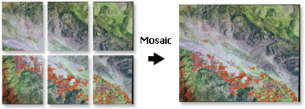
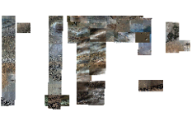
How GIS Tools Store Images
Mosaic Data:
When dealing with a large amount of raster images, a mosaic can be created.
Collection of rasters overlapped to create one larger image.
Drops discontinuous imagery
Notes:
Hep

Slide 20
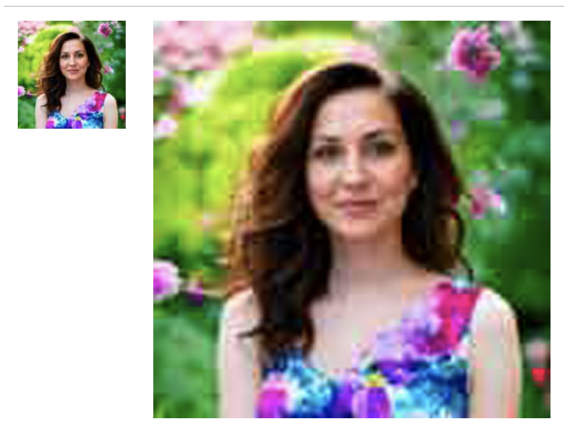
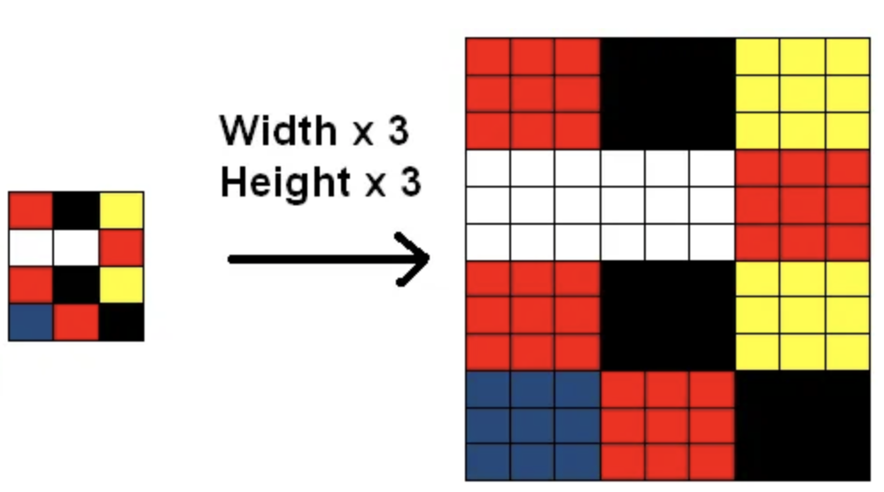
Transformation: Up Sampling
Up-sampling, also known as upsizing or interpolation, refers to the process of increasing the resolution of an image by adding more pixels into it. This process aims to increase the size and detail of the image without losing quality.
Purpose
Methods

Slide 21
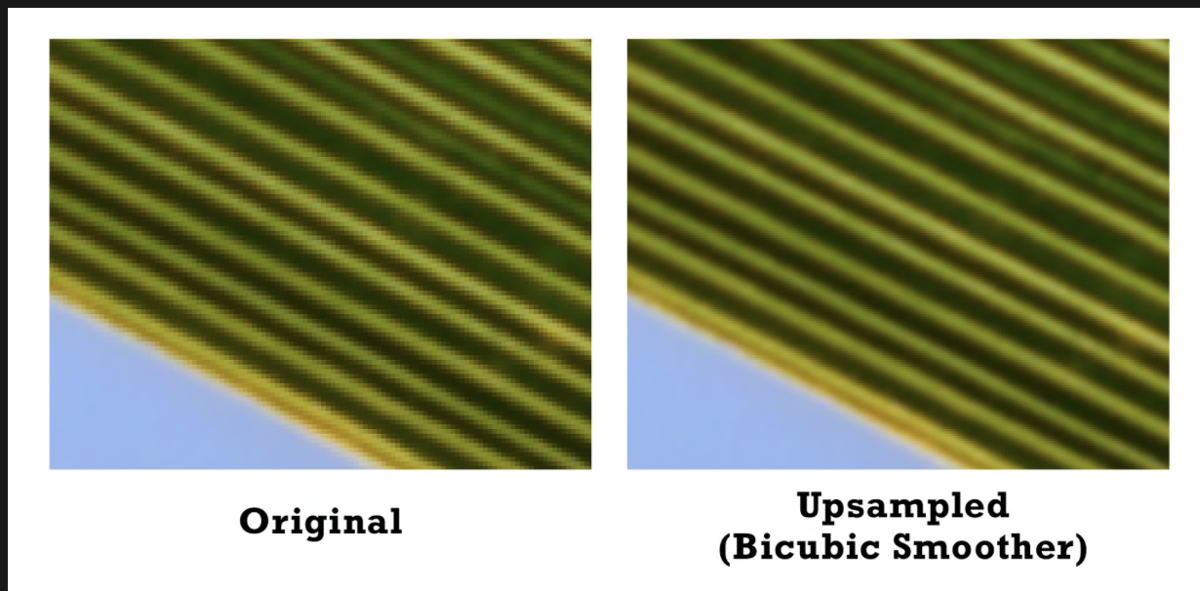
Up Sampling Applications
Image Restoration: In digital forensics and archival work, up-sampling is used to restore old or low-quality images to a higher resolution.
High-Resolution Imaging: For advertising and professional photography, up-sampling allows for the creation of high-resolution images from lower-resolution originals.
Medical Imaging: Enhancing the resolution of medical images (e.g., MRI, CT scans) for better diagnosis and analysis.
Machine Learning and AI: In certain AI applications, up-sampling is used to increase the resolution of input images for improved model performance, especially in tasks like super-resolution.

Slide 22
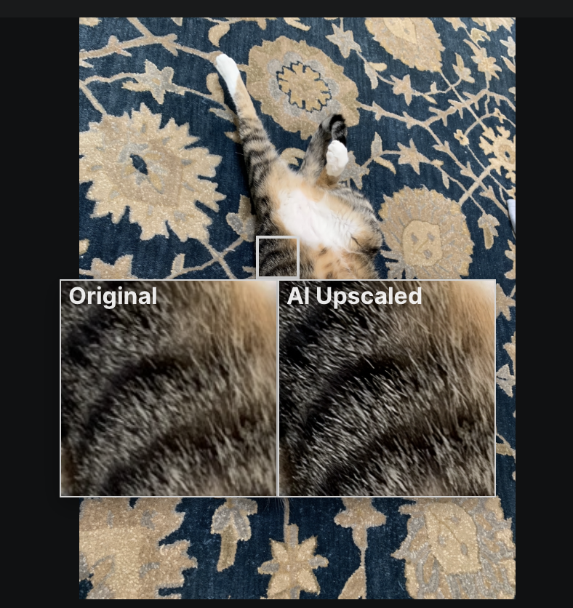
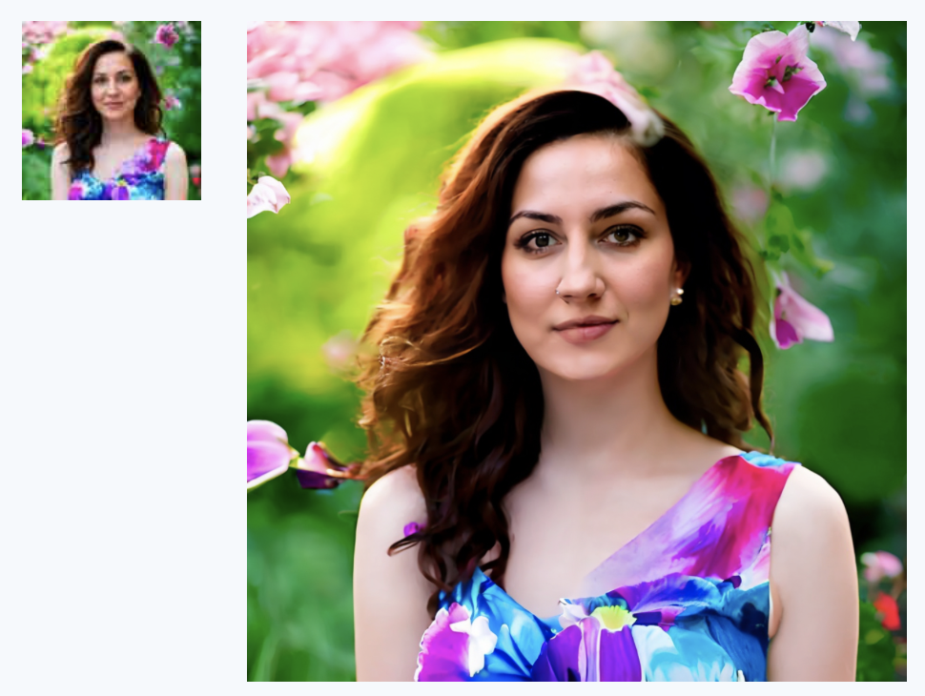
Transformation: Up Sampling
Up sampling with neural networks
CodeFormer & R-ESRGAN 4x+
ControlNet
Stable Diffusion
“Dead fish eyes”

Slide 23
Transformation: Down Sampling
Down Sampling: Down-sampling, also known as subsampling or decimation, is the process of reducing the resolution of an image. This is achieved by decreasing the number of pixels in the image, effectively reducing its size and detail.
Reduce Image Size: Down-sampling decreases the file size of an image, making it easier to store and transmit. This is crucial for applications with limited bandwidth or storage capacity.
Decrease Computational Requirements: Processing smaller images requires less computational power and memory, speeding up image processing tasks.
Adapt Images for Different Devices: By reducing image resolution, down-sampling helps adapt high-resolution images for display on devices with lower display resolutions.

Slide 24
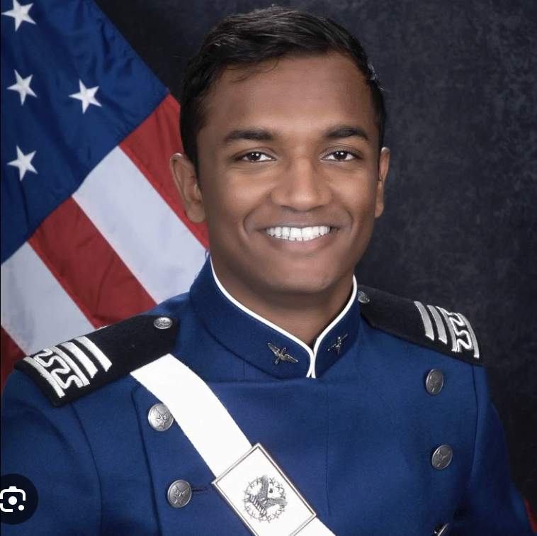
Down Sampling Applications
Image Compression: Down-sampling is a key step in many image compression algorithms, where reducing image size without significantly compromising quality is essential.
Reducing Computational Load: In machine learning and computer vision, down-sampling is used to decrease the computational complexity of image analysis and processing.
Multi-Resolution Analysis: In applications like digital zooming in cameras or pyramidal representation in image editing and computer graphics, down-sampling is used to create multiple resolutions of the same image.
Optimizing for Display: Adjusting high-resolution images to fit the resolution of various display devices (e.g., smartphones, tablets) without overburdening the device's processing capabilities

Slide 25
POP Quiz
Which of the following best describes the purpose of image upsampling?
A) To reduce the size of an image file for easier storage and faster transmission. B) To enhance the resolution of an image by increasing the number of pixels, making it appear sharper and more detailed. C) To compress an image by removing unnecessary pixels, thus decreasing its quality. D) To change the color palette of an image without altering its size or resolution.

Slide 26

POP QUIZ
Which of the following best describes the purpose of image upsampling?
A) To reduce the size of an image file for easier storage and faster transmission. B) To enhance the resolution of an image by increasing the number of pixels, making it appear sharper and more detailed. C) To compress an image by removing unnecessary pixels, thus decreasing its quality. D) To change the color palette of an image without altering its size or resolution.

Slide 27
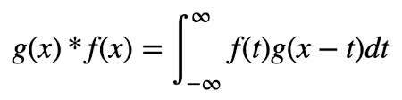
Convolution Equation
The convolution of f and g is written f∗g, denoting the operator with the symbol (∗). It is defined as the integral of the product of the two functions after one is reflected about the y-axis and shifted. As such, it is a particular kind of integral transform:

Slide 28
Convolution Equation
Continuous Equations:

Slide 29
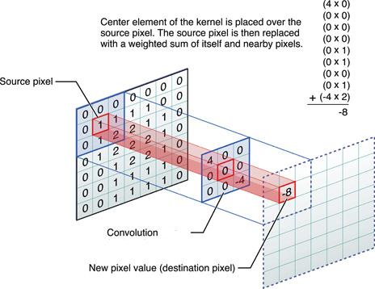
Kernels
Kernels, play a central role in image processing and Convolutional Neural Networks (CNNs) for deep learning.
Kernels are the matrix
Convolutions are the resulting matrix from applying Kernels

Slide 30
Kernels

Slide 31
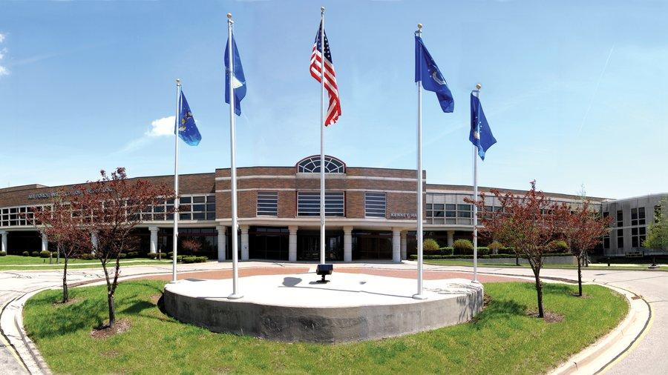
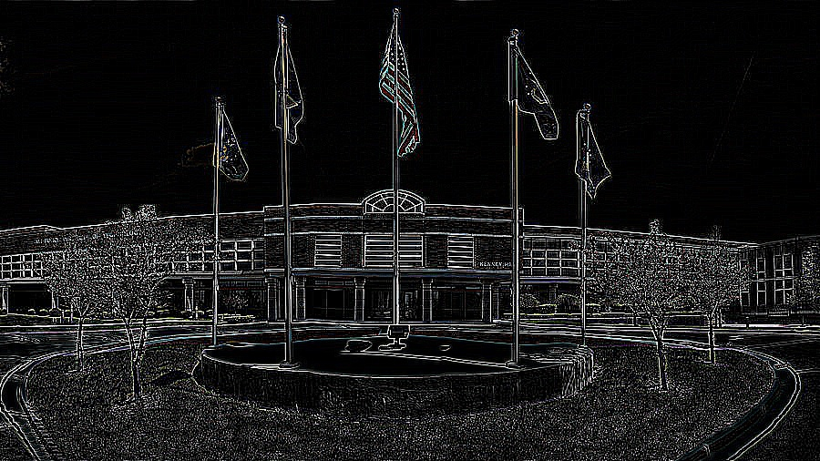
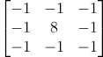
Transformation: Convolutions - Edge Detection
Input:
Output:
Kernel

Slide 32
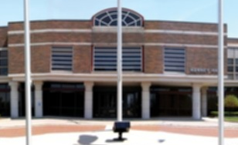
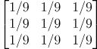
Transformation: Convolutions - Gaussian Blur
Input:
Output:
Kernel

Slide 33
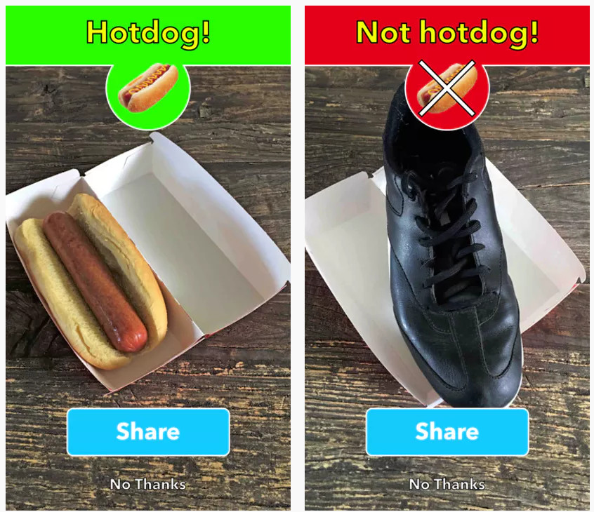
Convolutional Neural Network
Applications in:
image and video recognition
recommender systems
image classification
image segmentation
medical image analysis
natural language processing
brain–computer interfaces
financial time series

Slide 34
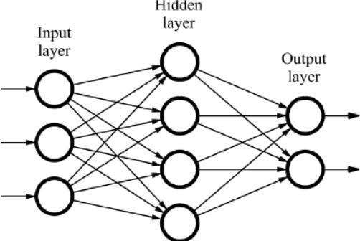
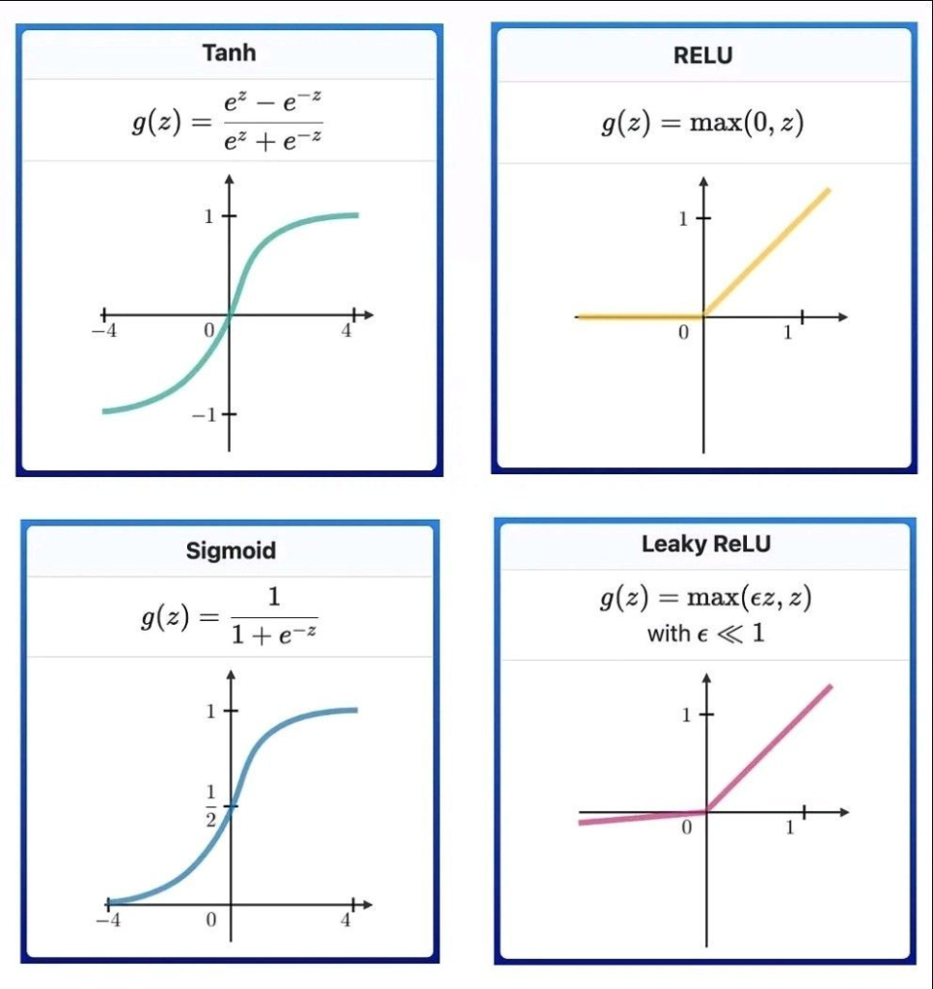
What is a Neural Network?
Neurons
Synapses
Activation Functions

Slide 35
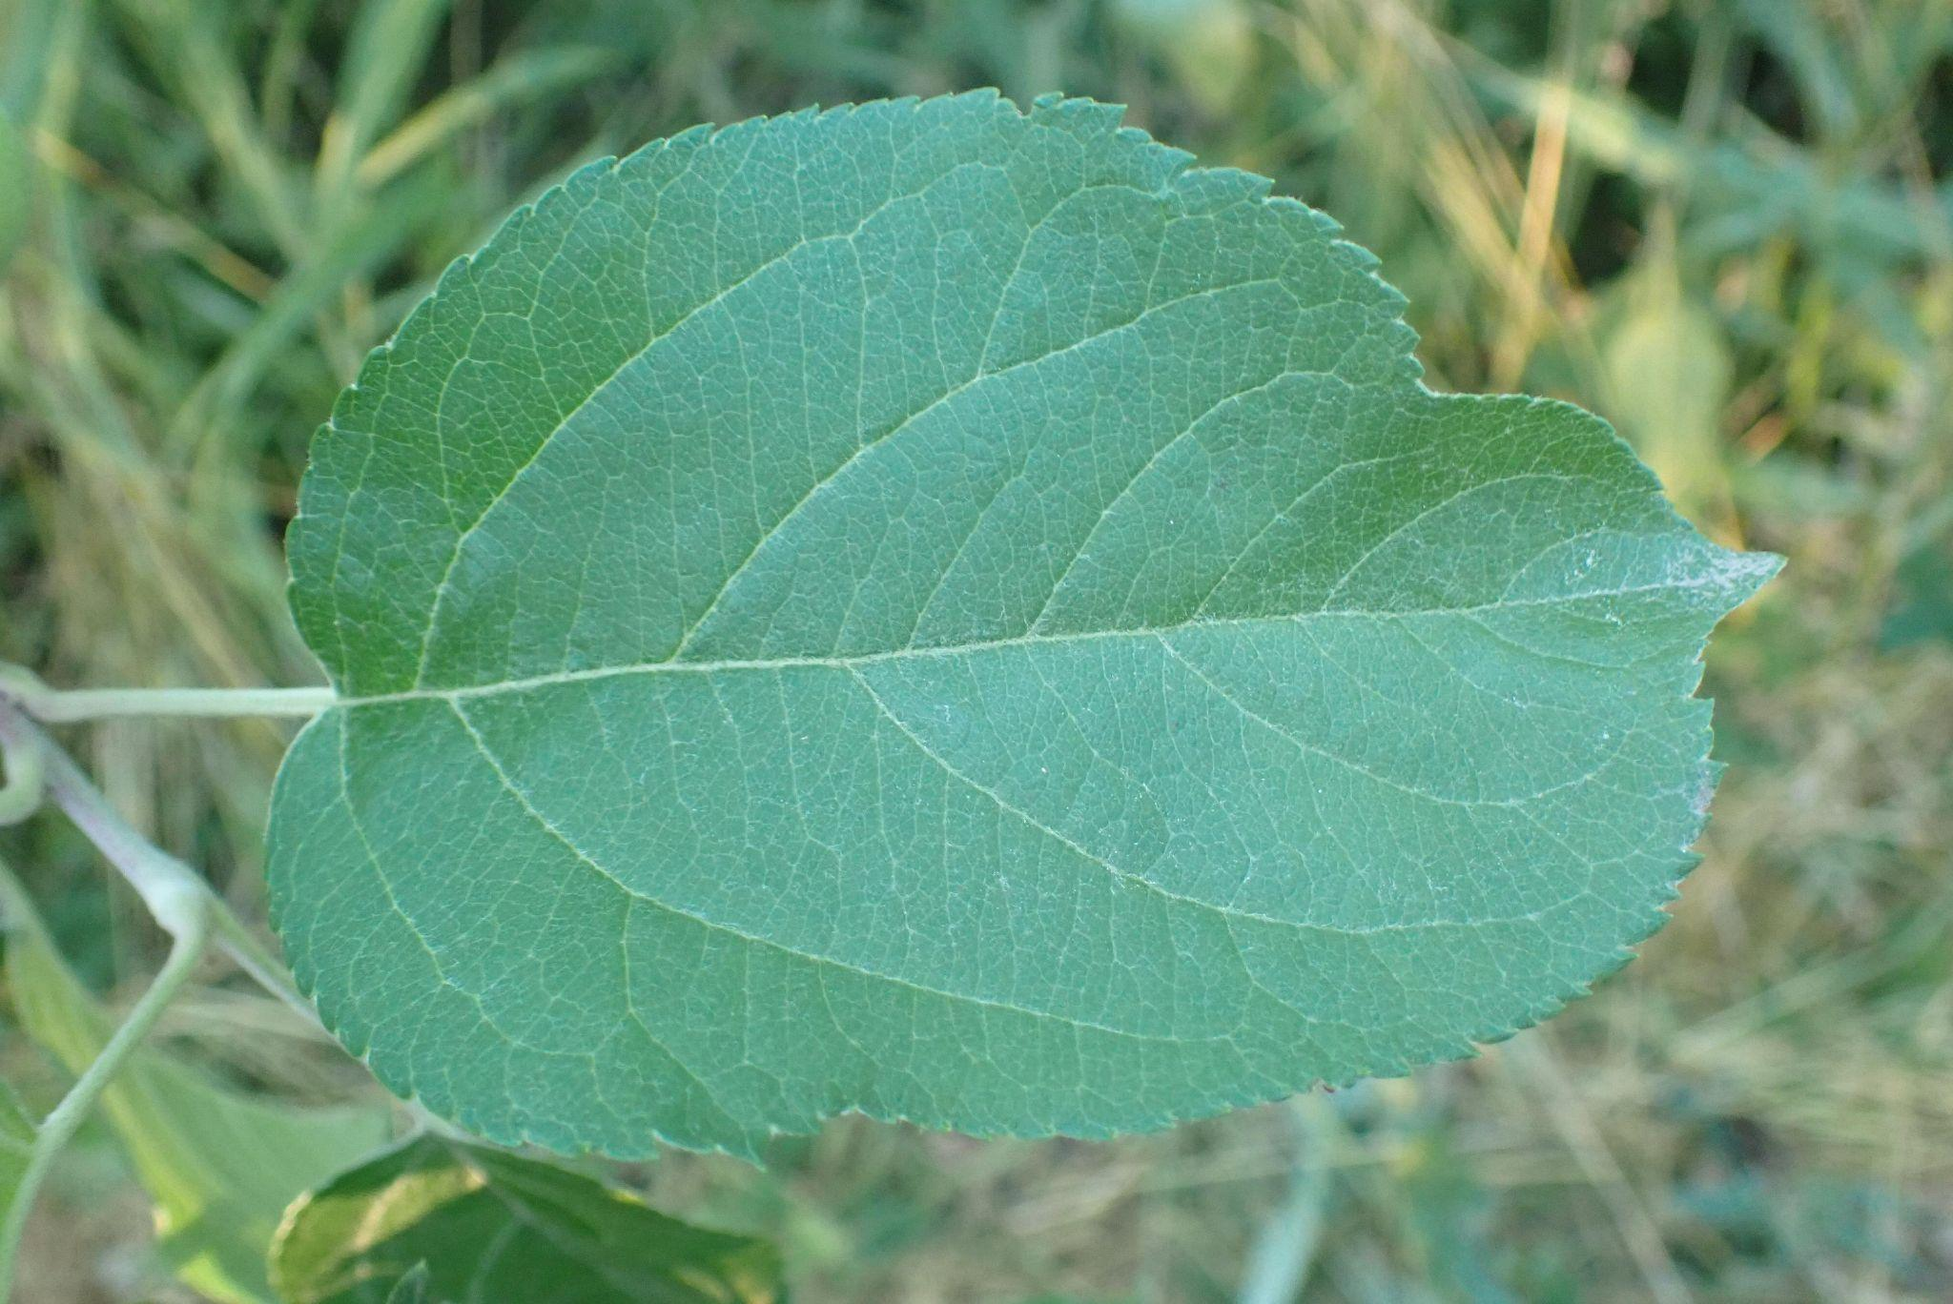
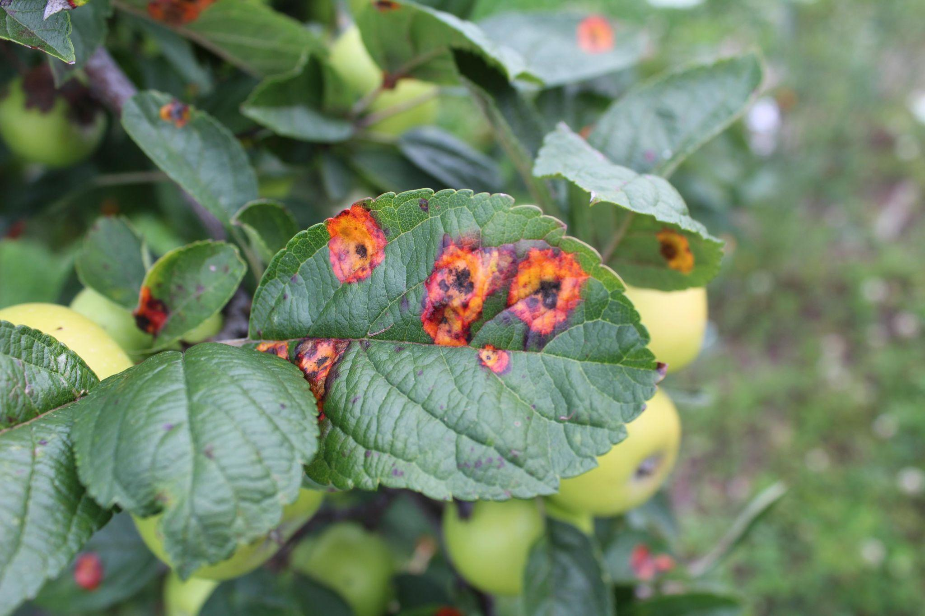
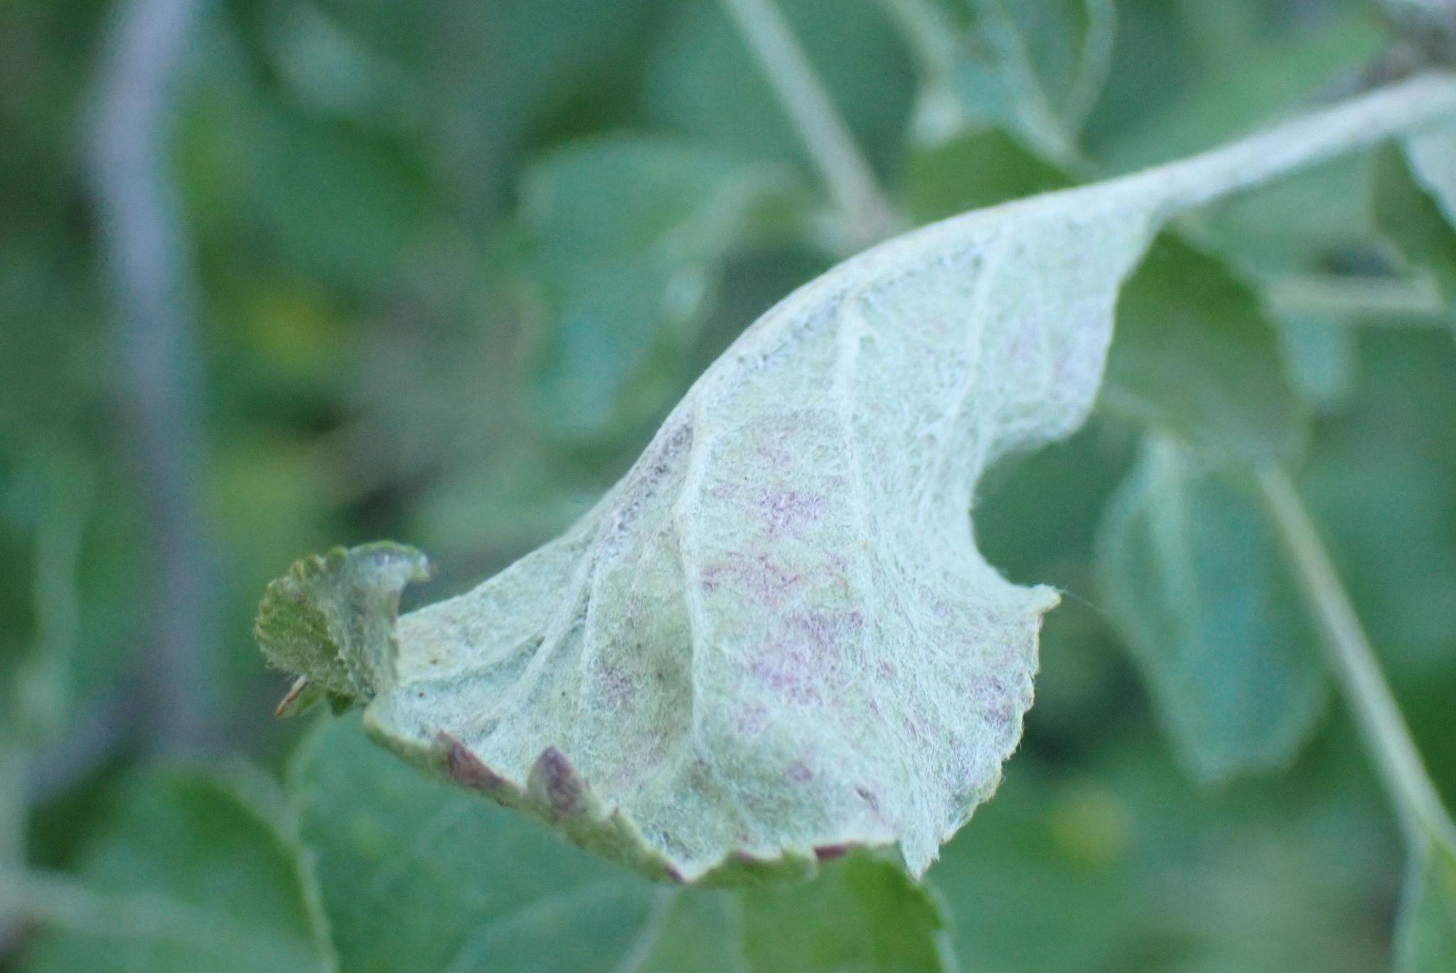
CNN: Leafy Dataset
Powdery
Healthy
Rusty

Slide 36
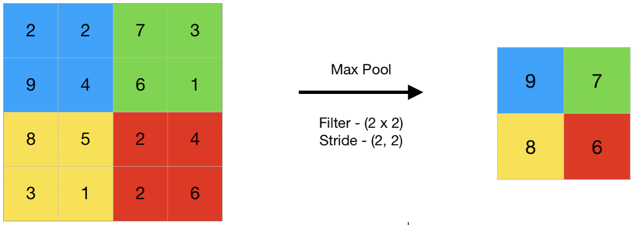
CNN: Max Pooling

Slide 37
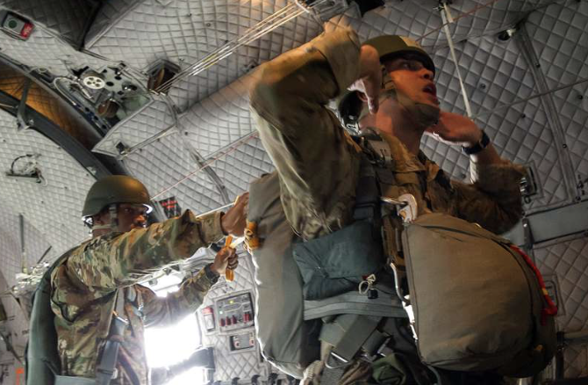
Questions?

